Slide 1

Heart Disease Risk Prediction using Framingham Data
Anton Bakulin
airenare@gmail.com

Slide 2
Contents
Introduction
Epidemiology of Heart Disease
Objectives of the Framingham Study
Data Overview
Exploratory Data Analysis
Data Preprocessing
Model Selection
Model Training and Evaluation
Conclusion

Slide 3
Introduction
Heart disease
Remains a leading cause of mortality worldwide
Influenced by multiple risk factors
The Framingham Study
Aims to predict heart disease risk within the next decade
Early detection and prevention

Slide 4
Epidemiology of Heart Disease
In the USA
Leading cause of death
23% of all deaths (~700k in 2020)
6.7% of adults have coronary heart disease (17.9 million)
Worldwide
Leading cause of death
32% of all deaths
85% of these deaths are from heart attacks and strokes
Particularly high in low- and middle-income countries
Although, affect people of all ages and backgrounds

Slide 5
Objectives of the Framingham Study
Develop a Prediction Screening Model
Identify individuals of high risk of CHD within a 10-year period
Maximize True Positives
Minimize False Negatives

Slide 6
Data Overview
The Framingham Heart Study dataset
Demographic
Age
Sex
Education level
Behavioral:
Smoking history
Medical history and tests
Heart rate, blood pressure measurements and medications, hypertension Dx
Diabetes Dx, blood glucose concentration
Cholesterol levels
History of stroke
BMI
10-year risk of coronary heart disease (CHD).

Slide 7
Exploratory Data Analysis

Slide 8
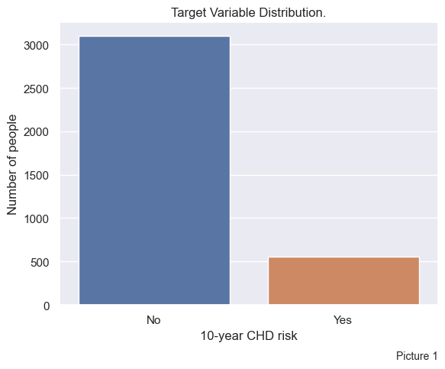
Target feature is highly imbalanced
Risk / No Risk = 1 / 5.6

Slide 9
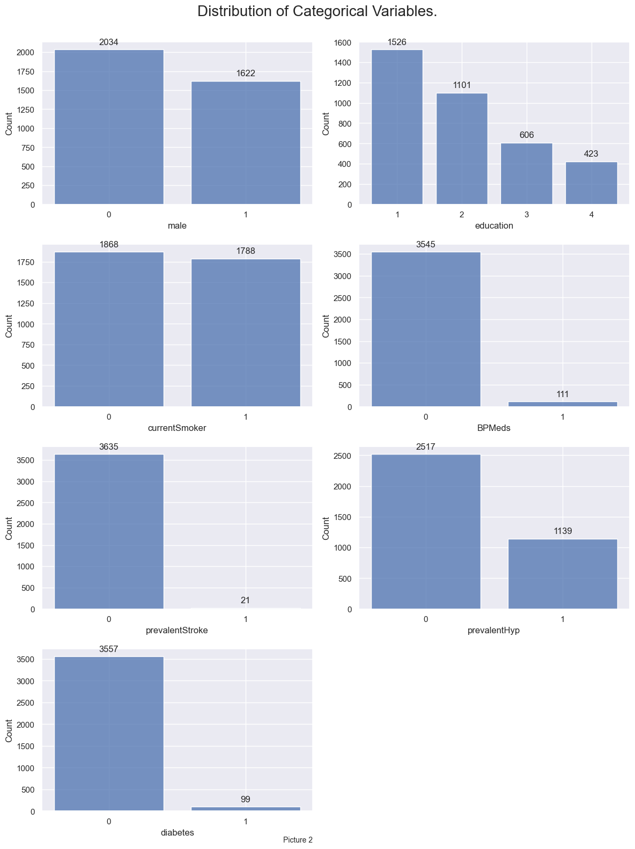
Categorical variables:
Balanced columns
Sex
Smoking History
Education
Usable columns
Hypertension history
Imbalanced columns
BP medications
Diabetes history
Stroke history

Slide 10
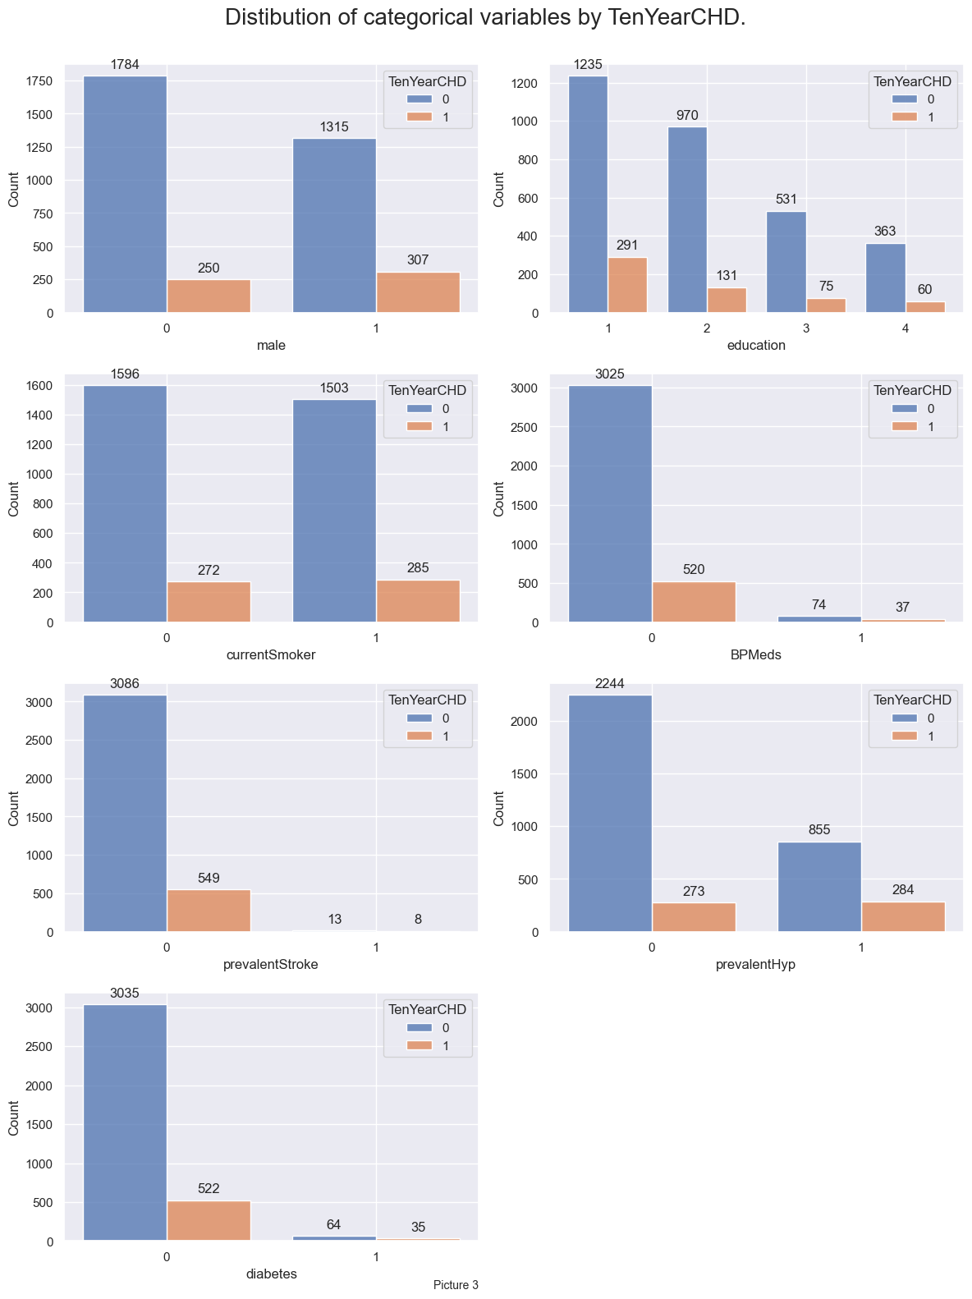
Target variable’s Categorical influencers:
Big impact
Being male
Hypertension
Medium impact
Smoking
Little to no impact
Education
Not enough data
BP medications
Stroke
Diabetes

Slide 11
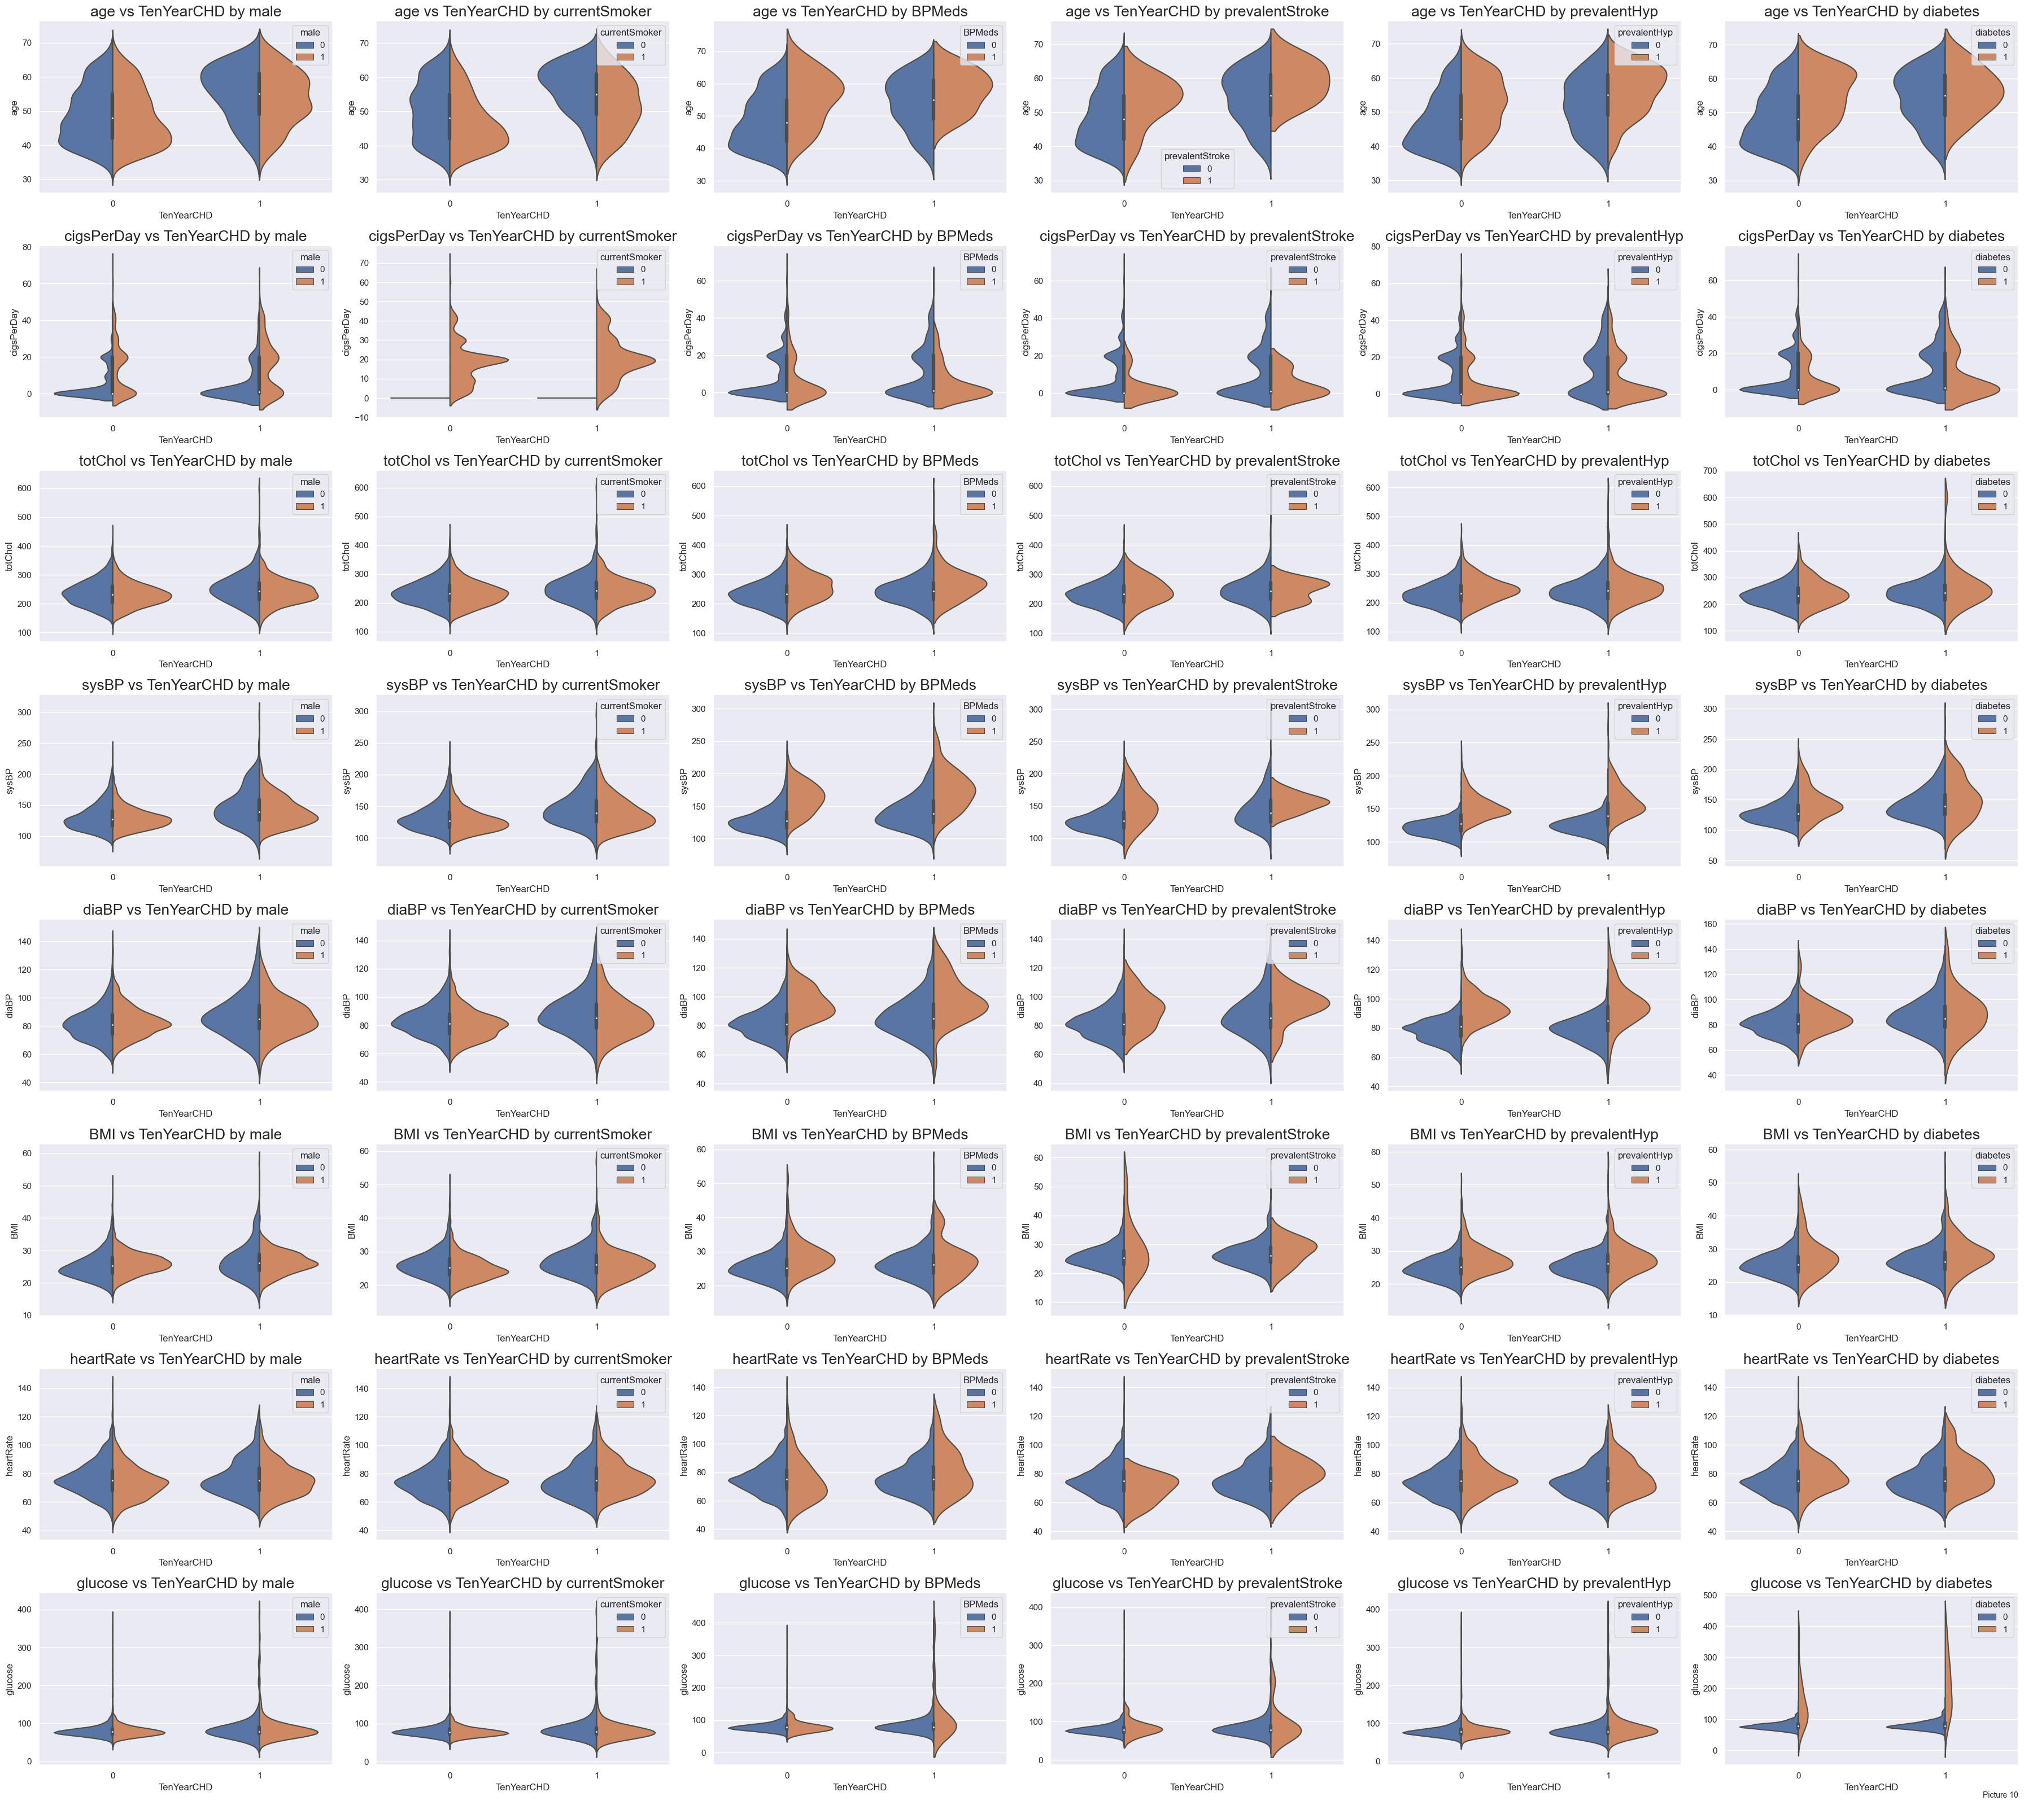
Continuous and Categorical influencers:
Big impact
Being male
Hypertension
Age
Medium impact
Smoking
# of cigarettes smoked per day
Glucose
Blood pressures
Little to no impact
Education
Not enough data
BP medications
Stroke
Diabetes
Notes:
Side notes: Many features have interesting but expected behaviors, shifting distributions if they are present:
Blood pressures tend to be higher in patients that are taking BP medications. Also, patients with higher BP tend to be already taking BP meds.
Diabetes flattens some distributions (except BMI, which is interesting, because higher BMI values usually linked to diabetes)

Slide 12
Data Preprocessing
Handling missing values
Dropping rows
Imputation
Feature engineering
Address collinearity among variables
Introduce new features

Slide 13


Feature Engineering
Smoking
Hypertension stages
Diabetes stages by Mean Arterial Pressure (MAP)

Slide 14
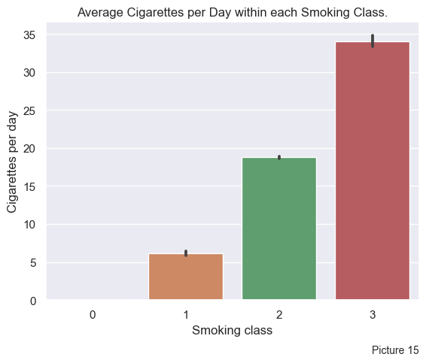
Smoking groups
Non-smokers
Half a pack per day
One pack per day
More than one pack per day

Slide 15
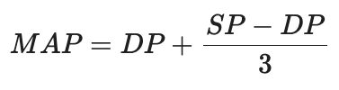
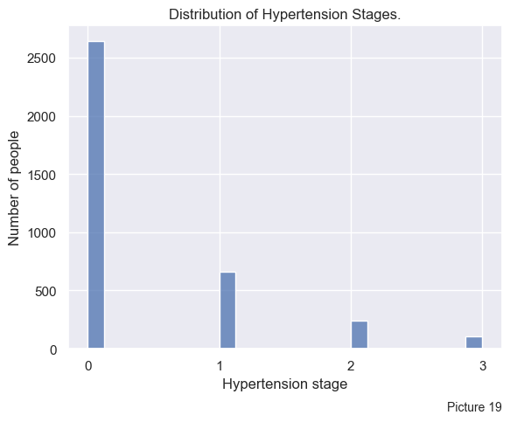
Hypertension stages by MAP
Normal: <100 ml/dl
Prediabetes: 100 to 125 mg/dl
Diabetes: > 125 mg/dl

Slide 16
Diabetes Stages
Normal: <100 ml/dl
Prediabetes: 100 to 125 mg/dl
Diabetes: > 125 mg/dl

Slide 17
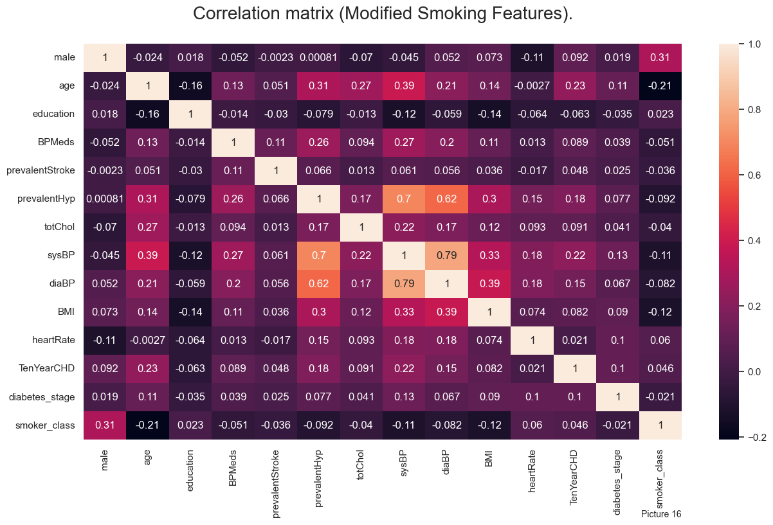
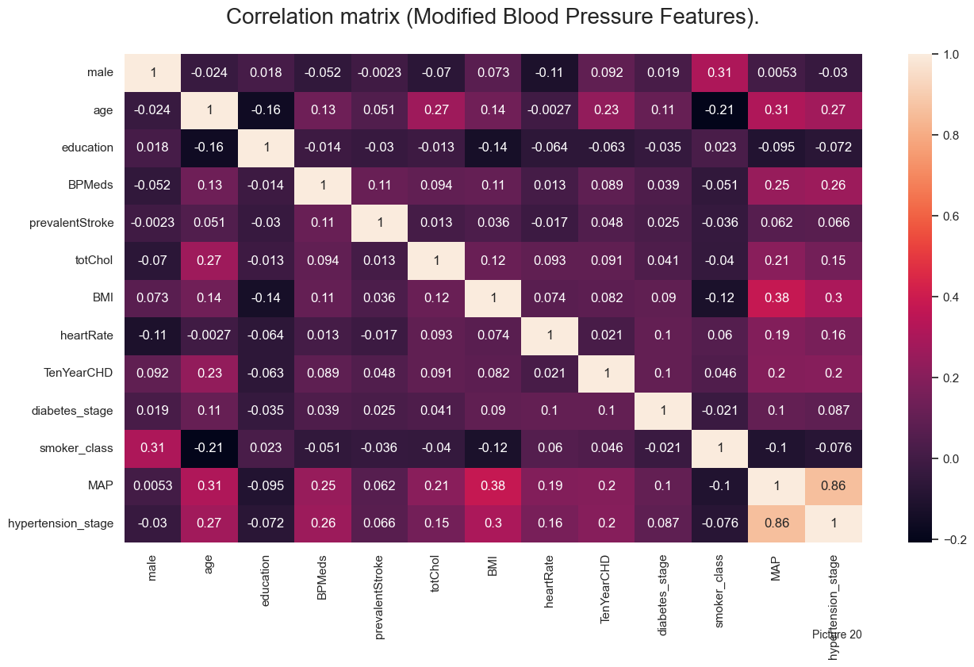
Correlation Matrices

Slide 18
Model Selection
Logistic Regression
Random Forest
SVM
Naïve Bayes
K Nearest Neighbors
AutoGluon (Auto-ML)

Slide 19
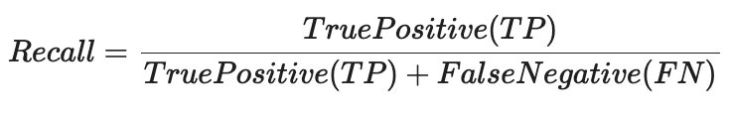
Performance metric
Max
TP
Min
FN
Smaller
FP

Slide 20
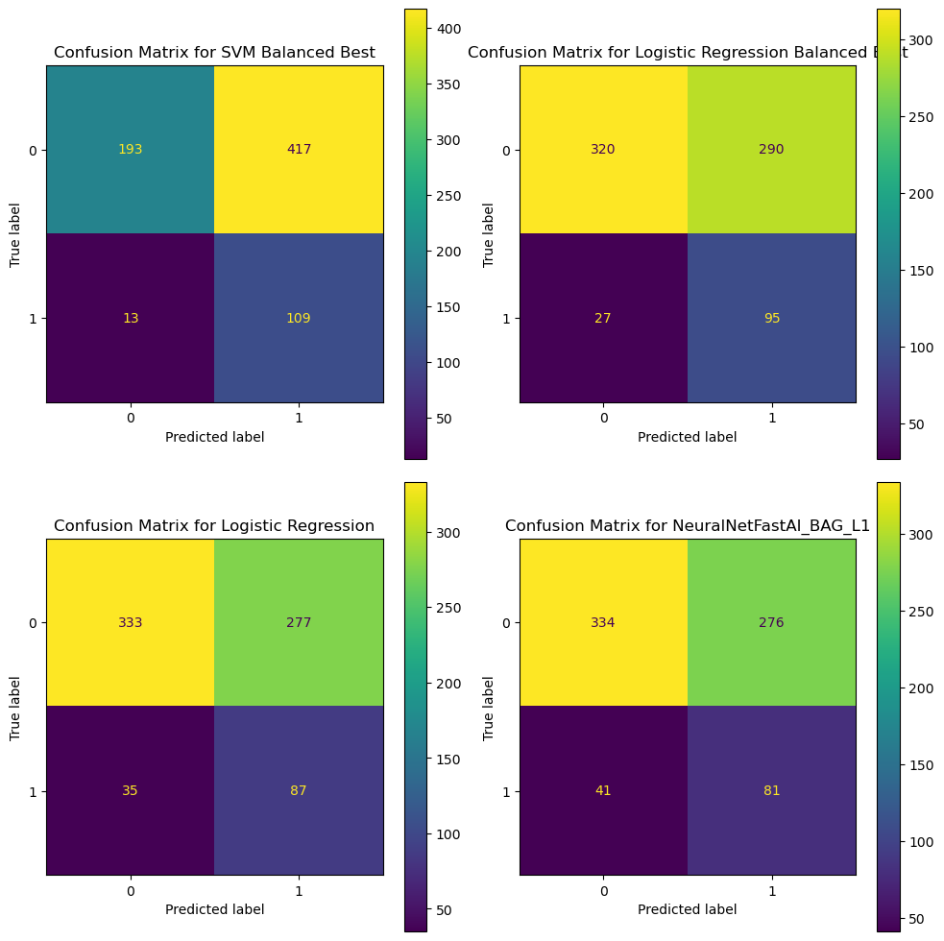
Model Training and Evaluation
Best Performance
Logistic Regression model with balanced class weights
balancing recall and precision effectively.
Comparison with other models
importance of minimizing false negatives and false positives in medical screening tests.

Slide 21
Conclusion
The balanced Logistic Regression model was found to perform the best across metrics
Goals:
Effective predicting CHD risk
Lowering potential impact on public health
Focusing on early detection and targeted interventions

